Slide 1

Restaurant Recommendation and Sentiment Analysis on Yelp Dataset
By
SatishReddy Bathula(CZ12651)

Slide 2
Project Description
Goal: Perform an initial exploratory analysis of the Yelp dataset to understand the distribution of ratings, and reviews and utilize machine learning techniques, such as sentiment analysis and text classification, to predict sentiment polarity and identify critical factors affecting positive or negative reviews and restaurant recommendation for the user.
Input Data: https://www.yelp.com/dataset
Input Data Specifications:
Dataset | Rows | Columns
Business | 50000 | 14
Reviews | 50000 | 9

Slide 3
Methodology
Data Preparation
Feature Probability Calculation
Class Probability Calculation
Recommedation

Slide 4
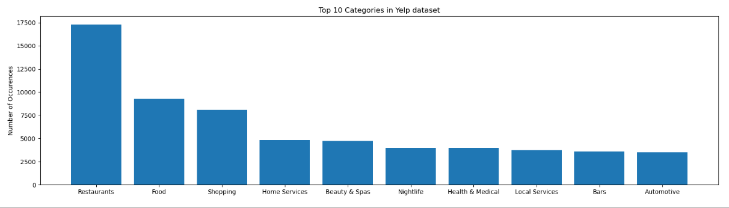
Top 10 Categories in Yelp Dataset
Restaurant and food are the top categories in the Yelp dataset.

Slide 5
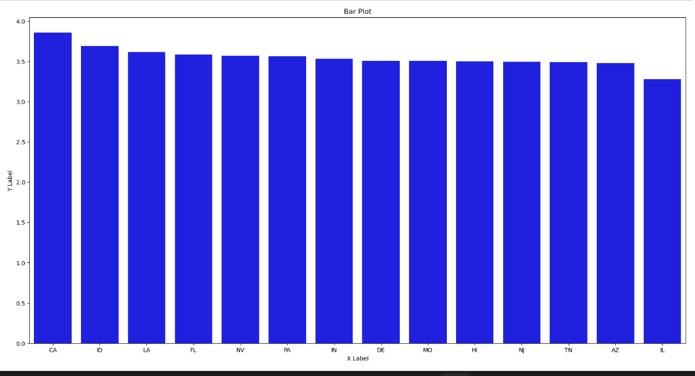
Average Rating Distribution

Slide 6
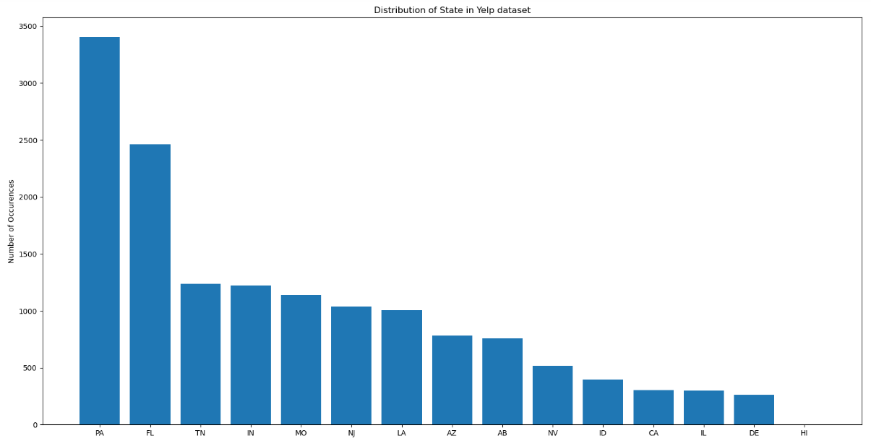
Distribution of state in Yelp dataset

Slide 7
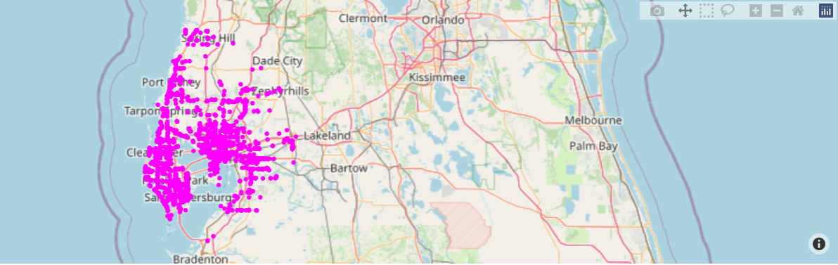
Distribution of restaurants in Florida

Slide 8
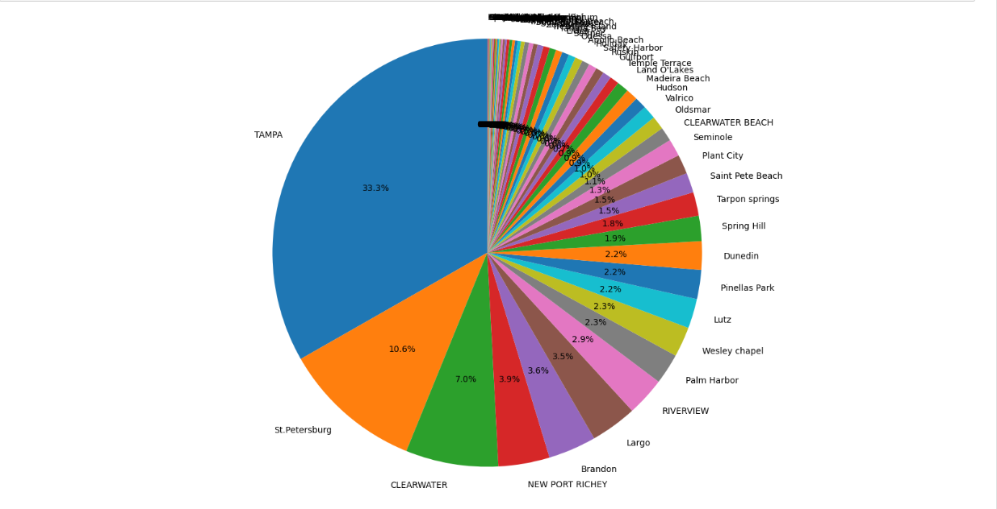
Percentage of restaurants by city in florida

Slide 9
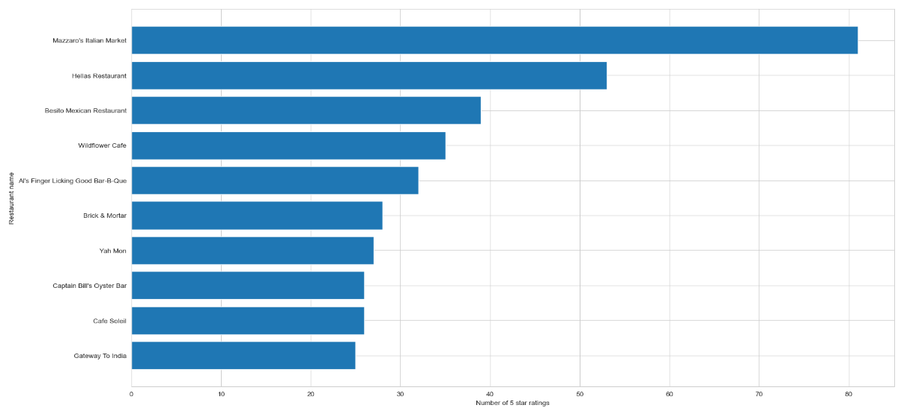
Five Star Rating Count

Slide 10
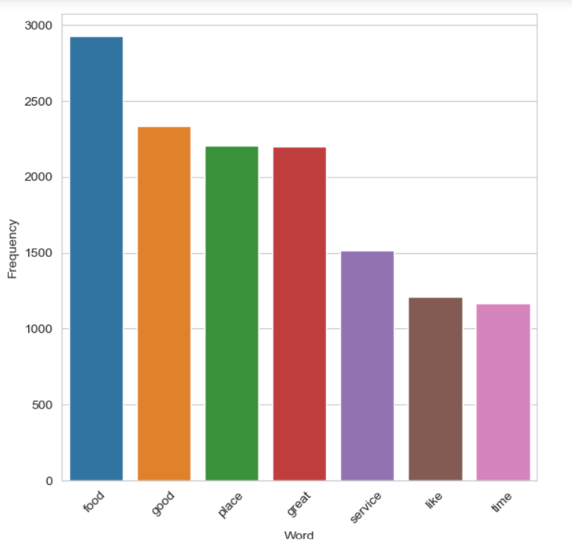
Word Frequency

Slide 11
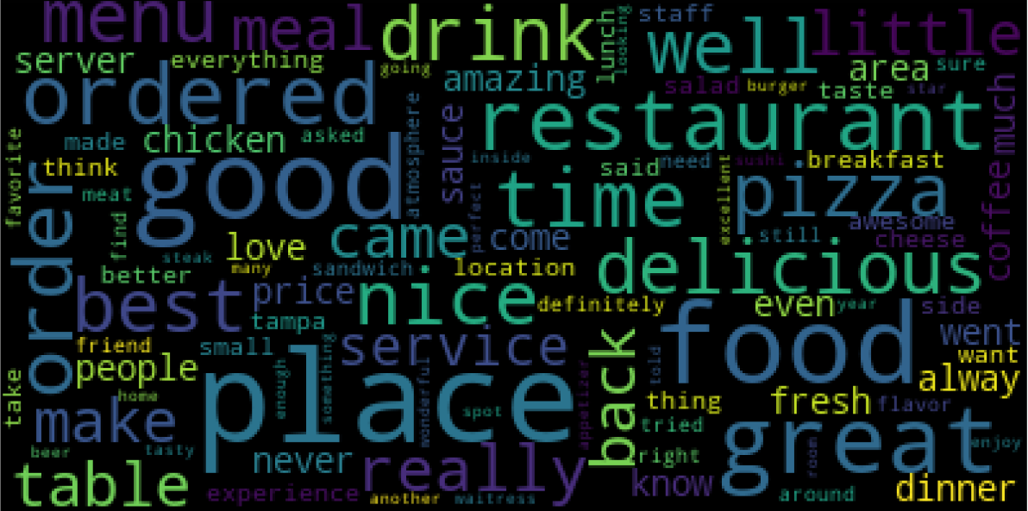
Word Cloud Of reviews

Slide 12
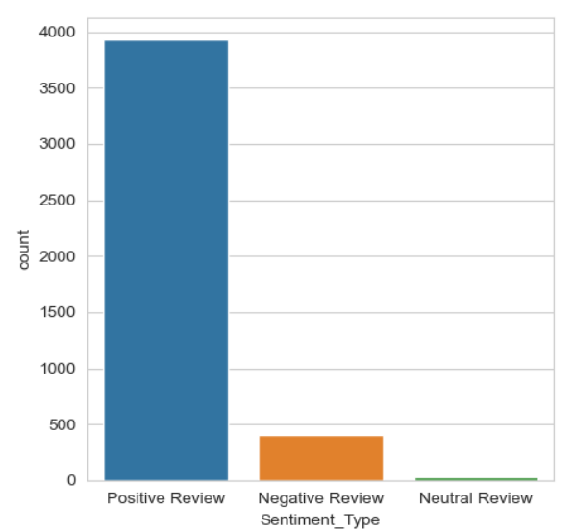
Sentiment Distribution

Slide 13
Algorithm
Multinomial Naïve Bayes Algorithm: The Multinomial Naive Bayes algorithm is a probabilistic classification technique based on Bayes' theorem. It is commonly used for text classification tasks, such as spam detection, sentiment analysis, and topic categorization.
It assumes that the features are conditionally independent.
Use Cases:
Product Recommendation.
News article Recommendation.
Movie Recommendations etc.

Slide 14
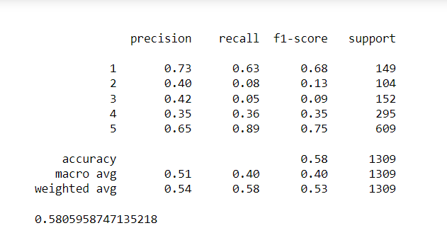
Classification Report

Slide 15
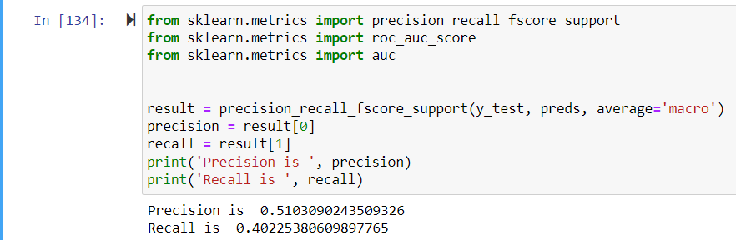
Precision and recall

Slide 16
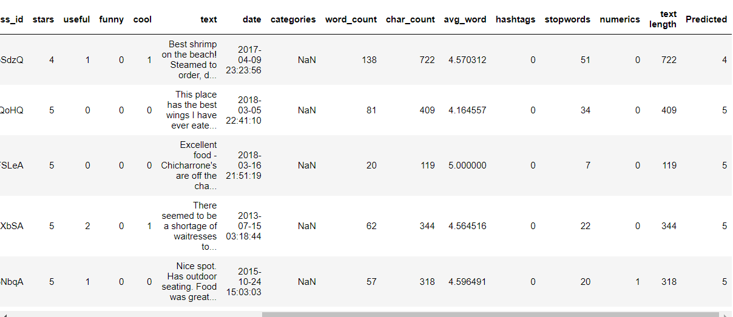
Predicted Reviews

Slide 17
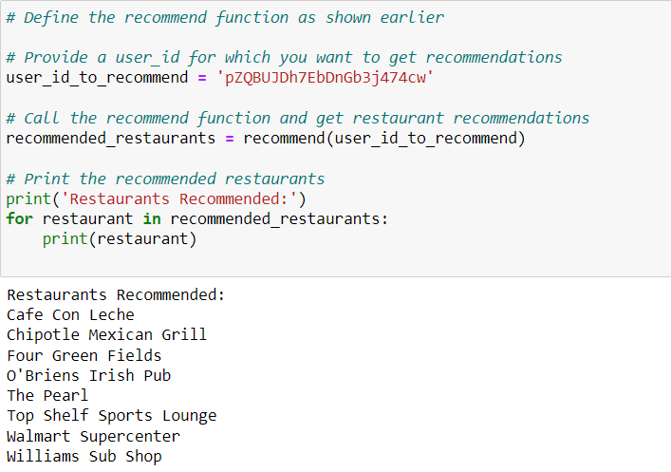
Restaurant Recomendation

Slide 18
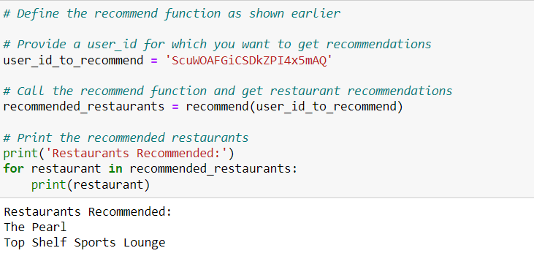
Restaurant Recommendation 2

Slide 19
Key Learnings
Restaurants which has the highest average rating have the highest reviews given to the customers which means if the service is good people tend to give ratings.
When you are dealing with huge data make sure you check the computational source because it will take a lot of time to work with the huge dataset.
Feedback plays a crucial role in popularity as it attracts customers from different places.

Slide 20
Future Scope
Can explore more recommendation algorithms like collaborative filtering and content-based filtering techniques.
Mobile app development by considering User’s preferences and choices so that they can select the restaurant based on their interests.
Exploring the integrating of geolocation and navigation features to guide users to their chosen restaurants and provide directions.

Slide 21
Thank you

